Slide 1
Administrative English
(Task Based)
Writing | Speaking | Reading | Vocabulary | Technology |
Real-World Scenarios

Slide 2
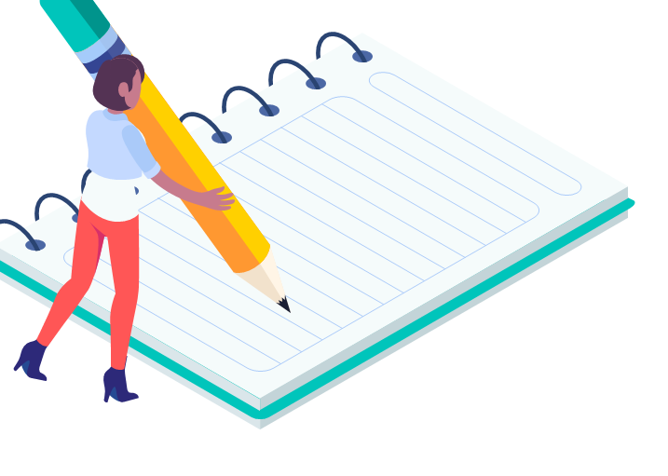
Writing
Formal Letter/Email Writing: Practice writing formal emails to parents, colleagues, or other stakeholders, adhering to proper email etiquette and using appropriate vocabulary.
Report Writing: Create reports on various topics relevant to Administrative administration, such as Offices attendance, budget allocation, or event summaries.
Minutes Taking: Practice taking accurate and concise minutes of meetings, summarizing key points and action items.
Notice Writing: Write clear and informative notices for Administrative announcements, events, or policy changes.
Filling out Forms: Complete various administrative forms in English, such as Offices registration forms, leave requests, or expense reports.
Creating Templates: Develop reusable templates for common administrative tasks, like email responses or meeting agendas.

Slide 3
Speaking
Answering Phones: Role-play phone conversations, practicing greetings, taking messages, and providing information.
Giving Instructions: Explain procedures, policies, or tasks clearly and concisely to colleagues or Offices.
Making Announcements: Practice delivering clear and confident announcements over the Administrative 's public address system.
Participating in Meetings: Engage in discussions, ask questions, and contribute ideas during meetings.
Small Talk: Develop conversational skills for informal interactions with colleagues and visitors.
Active Listening: Practice active listening techniques to understand and respond appropriately to spoken English.

Slide 4

Reading
Understanding Documents: Read and comprehend various Administrative -related documents, such as policies, handbooks, and memos.
Interpreting Forms: Accurately interpret the information on various administrative forms.
Reading Emails and Correspondence: Understand the content of emails and other written communications from various stakeholders.
Skimming and Scanning: Develop skills in quickly identifying key information in lengthy documents.

Slide 5
Vocabulary and Grammar
Specialized Vocabulary: Learn and use vocabulary specific to Administrative administration, such as terms related to finance, human resources, or Offices services.
Grammar Exercises: Practice grammar rules relevant to formal writing and speaking.
Common Phrases and Idioms: Learn common phrases and idioms used in administrative contexts.

Slide 6

Technology
Spreadsheet Software: Learn to use spreadsheet software for tasks like data entry, creating charts, and managing information.
Email Management: Practice using email software effectively, including organizing emails, creating folders, and managing contacts.
Online Meeting Platforms: Familiarize yourself with online meeting platforms and practice using their features.

Slide 7

Real World Scenarios
Handling Difficult Situations: Role-play scenarios involving challenging situations, such as dealing with complaints or resolving conflicts.
Prioritizing Tasks: Practice prioritizing tasks and managing workload effectively.
Working Under Pressure: Simulate situations where you need to perform administrative tasks under pressure.

Slide 8
“Ohne Fleiß kein Preis." - "Without diligence, no prize.
The harder you work, the luckier you get
The secret of getting ahead is getting started. – Mark Twain
If you can dream it, you can do it. – Walt Disney
By failing to prepare, you are preparing to fail. – Benjamin Franklin
It doesn’t matter how slowly you go as long as you do not stop. – Confucius
Tell me and I forget. Teach me and I remember. Involve me and I learn. – Benjamin Franklin

